Slide 1


Digital Signal Processing Project
Active Noise Cancellation (ANC) System for Audio Signal
24BEE0103
Mayank pal
mayank.pal2024@vitstudent.ac.in
8109081492

Slide 2


Project Objective & Focus
System Goal
Frequency-Domain Transformation
Utilizes FFT/IFFT blocks to break down acoustic signals into discrete spectral bands for efficient parallel filtering.
To design and simulate an adaptive Active Noise Cancellation (ANC) system using MATLAB/Simulink for reducing unwanted acoustic noise.
Adaptive Gain Control
Dynamically updates filter weights using error feedback loops to adjust anti-noise characteristics in real-time.
The system processes noise in the frequency domain using FFT/IFFT transformation and employs adaptive gain control based on error feedback to generate anti-noise and improve desired audio quality.
Acoustic Noise Reduction
Achieves high SNR audio enhancement by generating precise phase-inverted signals for acoustic suppression.

Slide 3

ANC System Methodology & Workflow
Audio Input + Additive Noise
Adaptive Gain Control / Error Feedback
Anti-Noise Generation
FFT Processing
IFFT Synthesis
ANC Clean Output
Fundamental Principle (Destructive Interference): The system continuously samples ambient acoustic noise, generates an anti-noise signal equal in amplitude but opposite in phase ( ), and combines it with the noisy signal to eliminate unwanted interference.

Slide 4


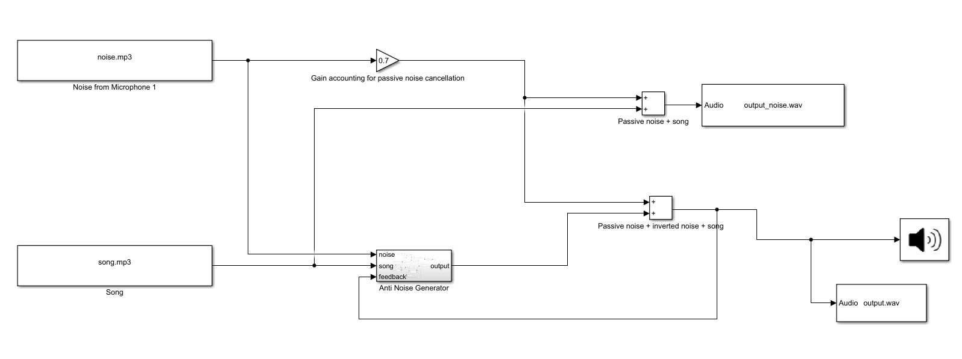
MATLAB/Simulink Simulation
Simulink Model Architecture

Slide 5
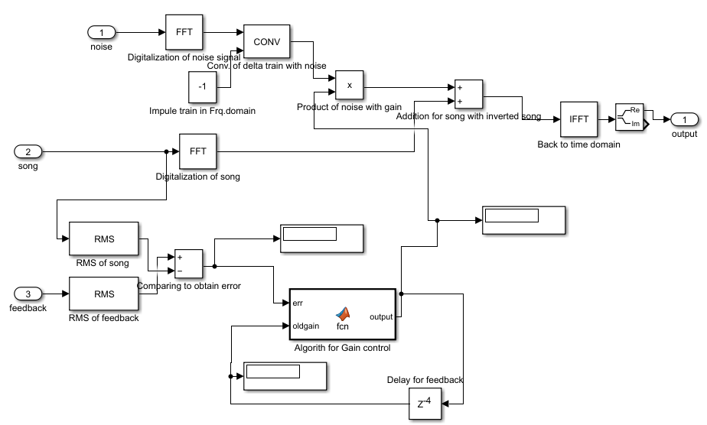
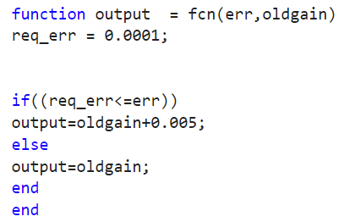
MATLAB/Simulink Simulation
Simulink Model Architecture
The code
Inside the Anti Noise Generator

Slide 6
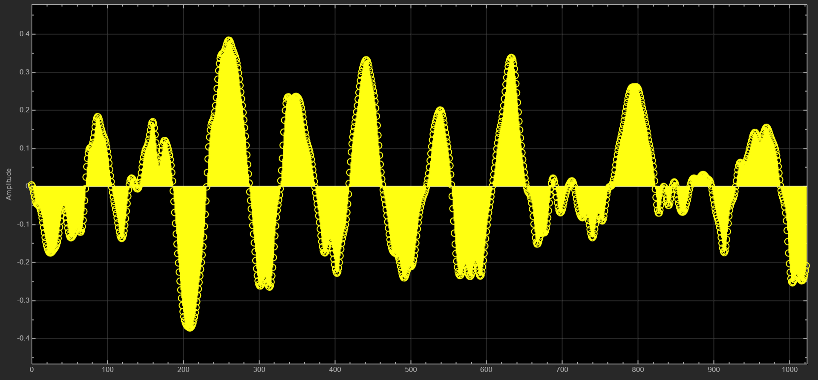
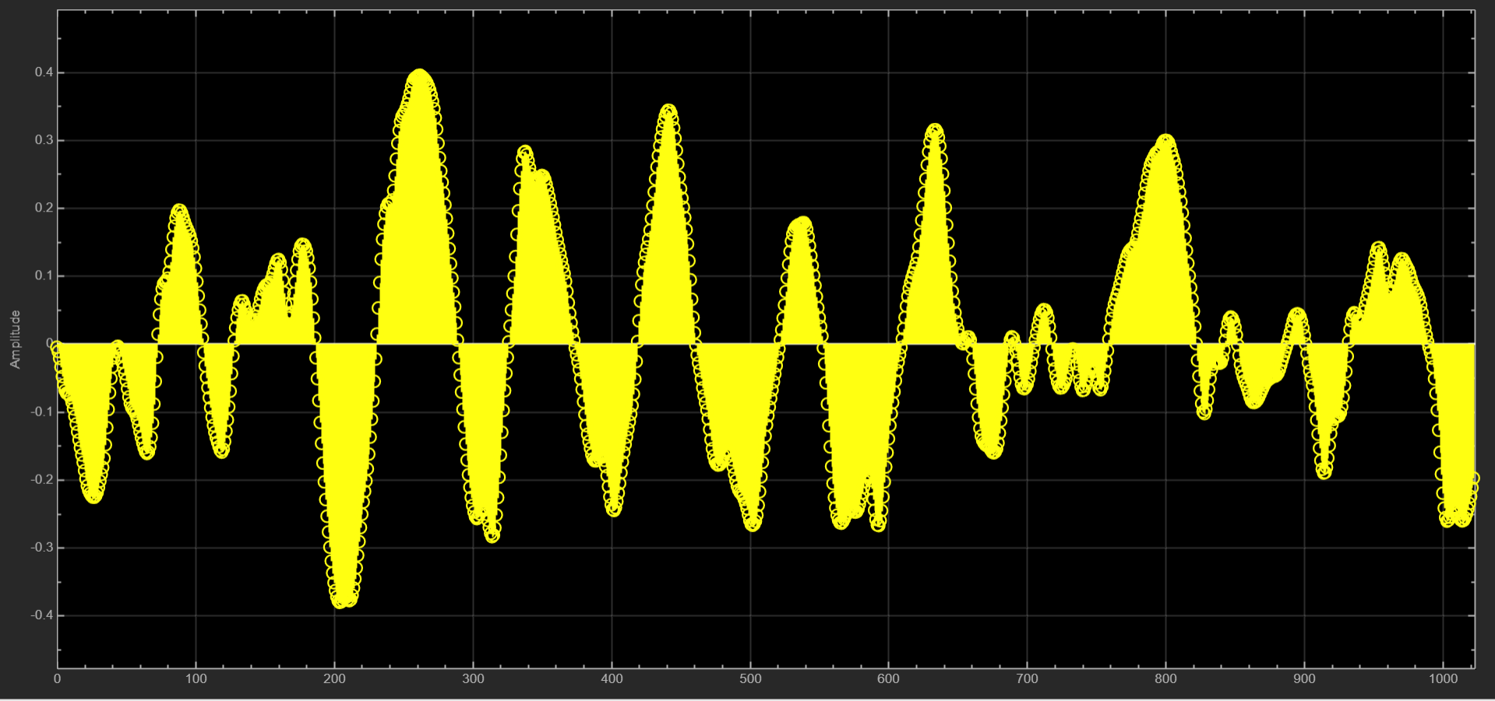
Result
Input Signal vs. ANC Output

Slide 7




Key Literature References
S. M. Kuo and D. R. Morgan, "Active Noise Control: A Tutorial Review," Proceedings of the IEEE, vol. 87, no. 6, 1999.
S. Haykin, Adaptive Filter Theory, 5th ed., Pearson Education, 2014.
A. V. Oppenheim and R. W. Schafer, Discrete-Time Signal Processing, 3rd ed., Pearson, 2010.
B. Widrow and S. D. Stearns, Adaptive Signal Processing, Prentice Hall, 1985.
P. S. R. Diniz, Adaptive Filtering: Algorithms and Practical Implementation, Springer, 2013.
S. M. Kuo and D. R. Morgan, Active Noise Control Systems: Algorithms and DSP Implementations, Wiley, 1996.
S. Elliott and P. Nelson, "Active Noise Control—A Tutorial Review," IEEE Signal Processing Magazine, 1999.
X. Shen et al., "Adaptive-gain algorithm on fixed filters applied for active noise control headphone," MSSP, vol. 169, 2022.
IJEEI Research Group, "Noise Cancellation Employing Adaptive Digital Filters," IJEEI Journal, 2019.
MathWorks / MATLAB Study, "Performance Analysis of Adaptive Noise Cancellation Algorithms (LMS, NLMS, RLS)," 2021.
* Additional secondary references available in the reviewed project literature.

